Slide 1
2. Software Life Cycle Models

Slide 2
Overview
Software development in theory
Iteration and incrementation
Risks and other aspects of iteration and incrementation
Managing iteration and incrementation
Other life-cycle models
Comparison of life-cycle models

Slide 3
6. Software Lifecycle Models
A software lifecycle model is a standardised
format for
planning
organising, and
running
a new development project.

Slide 4
Hundreds of different kinds of models are
known and used.
Many are minor variations on just a small
number of basic models. In this section we:
survey the main types of model, and
consider how to choose between them.

Slide 5
6.1. Planning with Models
SE projects usually live with a fixed financial
budget. (An exception is maintainance?)
Additionally, time-to-market places a strong
time constraint.
There will be other project constraints such
as staff.

Slide 6
designers
programmers
managers
money
staff
Project constraints
Computing
resources
time
Examples of Project Constraints

Slide 7
Project planning is the art of scheduling the
necessary activities, in time, space and across
staff in order to optimise:
project risk [low] (see later)
profit [high]
customer satisfaction [high]
worker satisfaction [high]
long-term company goals

Slide 8
What is a Lifecycle Model?
Definition.
A (software/system) lifecycle model is a
description of the sequence of activities
carried out in an SE project, and the relative
order of these activities.

Slide 9
Software Life Cycle
The term “Lifecycle” is based on the metaphor of the life of a person:
Conception
Childhood
Adulthood
Childhood
Retirement
Pre- Development
Post- Development
Development

Slide 10
Software Development Activities
Requirements Analysis
What is the problem?
Application
Domain
System Design
What is the solution?
What are the best mechanisms
Detailed Design
to implement the solution?
Solution
Domain
Program Implementation
How is the solution
constructed?
Testing
Is the problem solved?
Delivery
Can the customer use the solution?
Maintenance
Are enhancements needed?

Slide 11
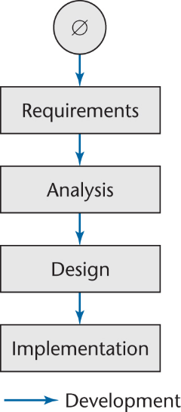
2.1 Software Development in Theory
Ideally, software is developed as described in Chapter 1
Linear
Starting from scratch

Slide 12
Software Development in Practice
In the real world, software development is totally different
We make mistakes
The client’s requirements change while the software product is being developed

Slide 13
It provides a fixed generic framework that
can be tailored to a specific project.
Project specific parameters will include:
Size, (person-years)
Budget,
Duration.
project plan =
lifecycle model + project parameters

Slide 14
There are hundreds of different lifecycle models
to choose from, e.g:
waterfall,
code-and-fix
spiral
rapid prototyping
unified process (UP)
agile methods, extreme programming (XP)
COTS …
but many are minor variations on a smaller
number of basic models.

Slide 15
By changing the lifecycle model, we can
improve and/or tradeoff:
Development speed (time to market)
Product quality
Project visibility
Administrative overhead
Risk exposure
Customer relations, etc, etc.

Slide 16
Normally, a lifecycle model covers the entire
lifetime of a product.
From birth of a commercial idea
to final de-installation of last release
i.e. The three main phases:
Design,
Build,
Maintain.

Slide 17
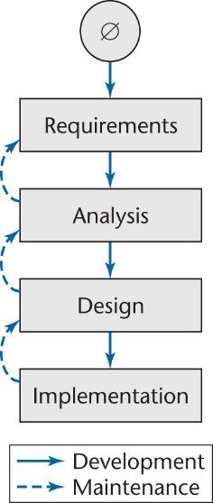
Waterfall Model
The linear life cycle model with feedback loops
The waterfall model cannot show the order of events

Slide 18
Iteration and Incrementation
In real life, we cannot speak about “the analysis phase”
Instead, the operations of the analysis phase are spread out over the life cycle
The basic software development process is iterative
Each successive version is intended to be closer to its target than its predecessor

Slide 19
Miller’s Law
At any one time, we can concentrate on only approximately seven chunks (units of information)
To handle larger amounts of information, use stepwise refinement
Concentrate on the aspects that are currently the most important
Postpone aspects that are currently less critical
Every aspect is eventually handled, but in order of current importance
This is an incremental process

Slide 20
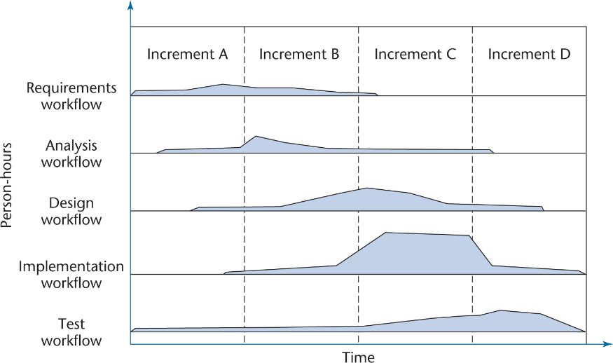
Iteration and Incrementation (contd)
Figure 2.4

Slide 21
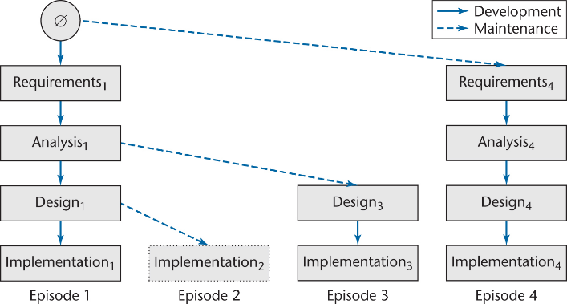
Iteration and Incrementation (contd)
Iteration and incrementation are used in conjunction with one another
There is no single “requirements phase” or “design phase”
Instead, there are multiple instances of each phase

Slide 22
Iteration and Incrementation (contd)
The number of increments will vary — it does not have to be four

Slide 23
Classical Phases versus Workflows
Sequential phases do not exist in the real world
Instead, the five core workflows (activities) are performed over the entire life cycle
Requirements workflow
Analysis workflow
Design workflow
Implementation workflow
Test workflow

Slide 24
Workflows
All five core workflows are performed over the entire life cycle
However, at most times one workflow predominates
Examples:
At the beginning of the life cycle
The requirements workflow predominates
At the end of the life cycle
The implementation and test workflows predominate
Planning and documentation activities are performed throughout the life cycle

Slide 25
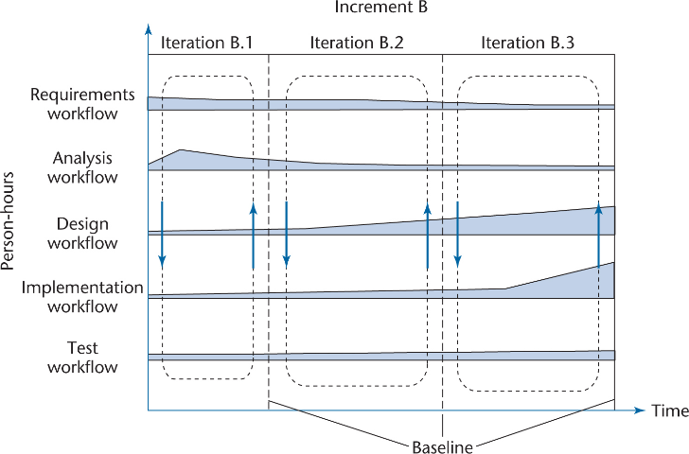
Iteration and Incrementation (contd)
Iteration is performed during each incrementation
Figure 2.5

Slide 26
Iteration and Incrementation (contd)
Again, the number of iterations will vary—it is not always three

Slide 27
More on Incrementation (contd)
Each episode corresponds to an increment
Not every increment includes every workflow
Increment B was not completed
Dashed lines denote maintenance

Slide 28
Risks and Other Aspects of Iter. and Increm.
We can consider the project as a whole as a set of mini projects (increments)
Each mini project extends the
Requirements artifacts
Analysis artifacts
Design artifacts
Implementation artifacts
Testing artifacts
The final set of artifacts is the complete product

Slide 29
Risks and Other Aspects of Iter. and Increm. (contd)
During each mini project we
Extend the artifacts (incrementation);
Check the artifacts (test workflow); and
If necessary, change the relevant artifacts (iteration)

Slide 30
Risks and Other Aspects of Iter. and Increm. (contd)
Each iteration can be viewed as a small but complete waterfall life-cycle model
During each iteration we select a portion of the software product
On that portion we perform the
Classical requirements phase
Classical analysis phase
Classical design phase
Classical implementation phase

Slide 31
Strengths of the Iterative-and-Incremental Model
There are multiple opportunities for checking that the software product is correct
Every iteration incorporates the test workflow
Faults can be detected and corrected early
The robustness of the architecture can be determined early in the life cycle
Architecture — the various component modules and how they fit together
Robustness — the property of being able to handle extensions and changes without falling apart

Slide 32
Strengths of the Iterative-and-Incremental Model (contd)
We can mitigate (resolve) risks early
Risks are invariably involved in software development and maintenance
We have a working version of the software product from the start
The client and users can experiment with this version to determine what changes are needed
Variation: Deliver partial versions to smooth the introduction of the new product in the client organization

Slide 33
Strengths of the Iterative-and-Incremental Model (contd)
There is empirical evidence that the life-cycle model works
The CHAOS reports of the Standish Group (see overleaf) show that the percentage of successful products increases

Slide 34
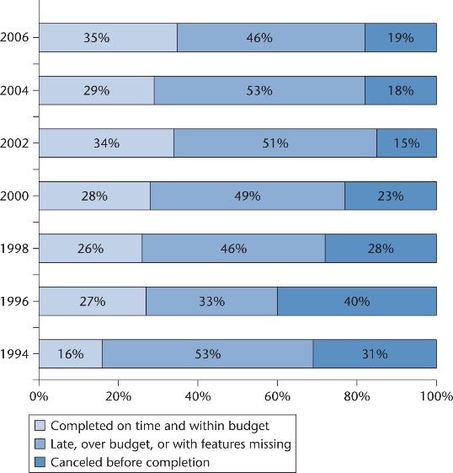
Strengths of the Iterative-and-Incremental Model (contd)
CHAOS reports from 1994 to 2006
Figure 2.7

Slide 35
Strengths of the Iterative-and-Incremental Model (contd)
Reasons given for the decrease in successful projects in 2004 include:
More large projects in 2004 than in 2002
Use of the waterfall model
Lack of user involvement
Lack of support from senior executives

Slide 36
Managing Iteration and Incrementation
The iterative-and-incremental life-cycle model is as regimented as the waterfall model …
… because the iterative-and-incremental life-cycle model is the waterfall model, applied successively
Each increment is a waterfall mini project

Slide 37
Other Life-Cycle Models
The following life-cycle models are presented and compared:
Code-and-fix life-cycle model
Rapid prototyping life-cycle model
Open-source life-cycle model
Agile processes
Synchronize-and-stabilize life-cycle model
Spiral life-cycle model

Slide 38
Code-and-Fix
This model starts with an informal general product idea and just develops code until a product is ”ready” (or money or time runs out). Work is in random order.
Corresponds with no plan! (Hacking!)

Slide 39
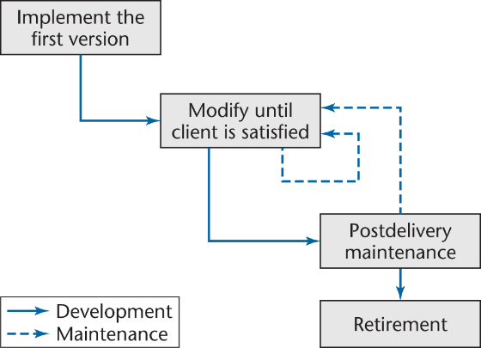
Code-and-Fix Model
No design
No specifications
Maintenance nightmare
Figure 2.8

Slide 40
Advantages
No administrative overhead
Signs of progress (code) early.
Low expertise, anyone can use it!
Useful for small “proof of concept” projects, e.g. as part of risk reduction.

Slide 41
Disadvantages
Dangerous!
No visibility/control
No resource planning
No deadlines
Mistakes hard to detect/correct
2. Impossible for large projects,
communication breakdown, chaos.

Slide 42
The Waterfall Model
The waterfall model is the classic lifecycle model – it is widely known, understood and (commonly?) used.
In some respect, waterfall is the ”common
sense” approach.
Introduced by Royce 1970.

Slide 43
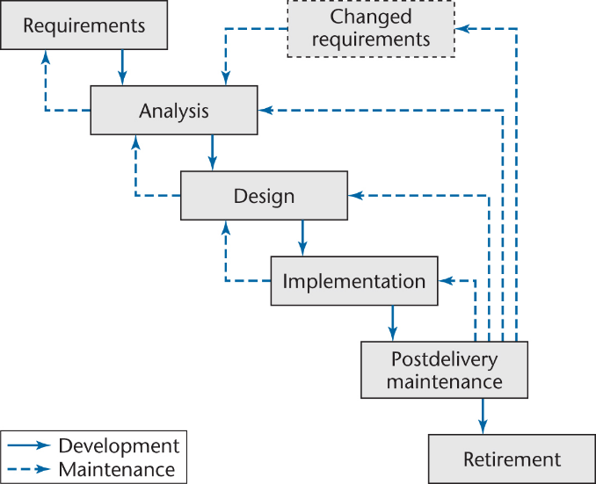
Waterfall Model
Figure 2.9

Slide 44
Advantages
Easy to understand and implement.
Widely used and known (in theory!)
Reinforces good habits: define-before- design, design-before-code
Identifies deliverables and milestones
Document driven, URD, SRD, … etc. Published documentation standards, e.g. PSS-05.
Works well on mature products and weak teams.

Slide 45
Disadvantages I
Idealised, doesn’t match reality well.
Doesn’t reflect iterative nature of exploratory development.
Unrealistic to expect accurate requirements so early in project
Software is delivered late in project, delays discovery of serious errors.

Slide 46
Rapid Prototyping
Key idea: Customers are non-technical and
usually don’t know what they want/can have.
Rapid prototyping emphasises requirements
analysis and validation, also called:
customer oriented development,
evolutionary prototyping

Slide 47
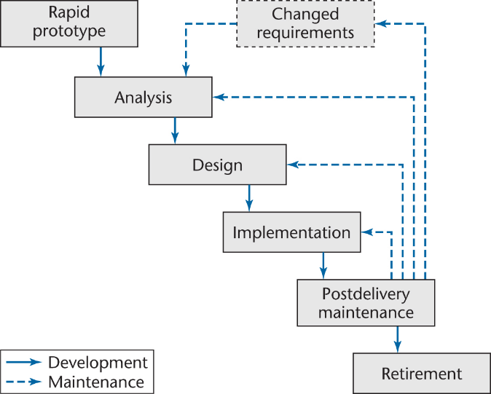
Rapid Prototyping Model
Linear model
“Rapid”
Figure 2.10

Slide 48
Advantages
Reduces risk of incorrect user requirements
Good where requirements are changing/uncommitted
Regular visible progress aids management
Supports early product marketing

Slide 49
Disadvantages
An unstable/badly implemented prototype often becomes the final product.
Requires extensive customer collaboration
Costs customers money
Needs committed customers
Difficult to finish if customer withdraws
May be too customer specific, no broad market

Slide 50
Open-Source Life-Cycle Model
Two informal phases
First, one individual builds an initial version
Made available via the Internet (e.g., SourceForge.net)
Then, if there is sufficient interest in the project
The initial version is widely downloaded
Users become co-developers
The product is extended
Key point: Individuals generally work voluntarily on an open-source project in their spare time

Slide 51
The Activities of the Second Informal Phase
Reporting and correcting defects
Corrective maintenance
Adding additional functionality
Perfective maintenance
Porting the program to a new environment
Adaptive maintenance
The second informal phase consists solely of postdelivery maintenance
The word “co-developers” on the previous slide should rather be “co-maintainers”

Slide 52
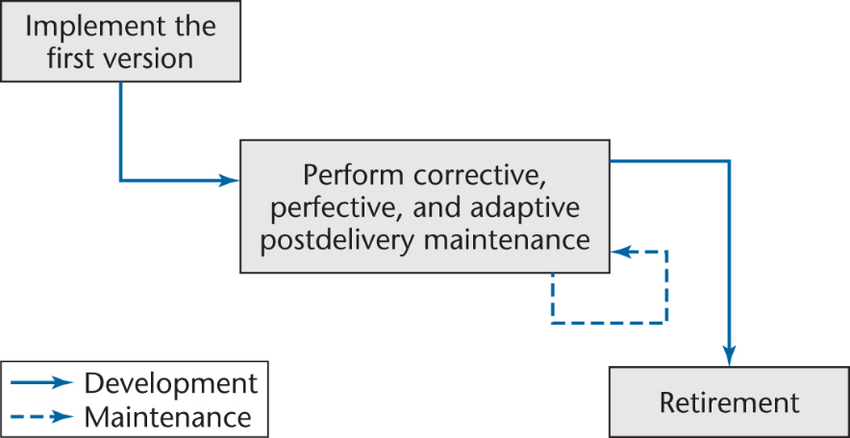
Open-Source Life-Cycle Model (contd)
Postdelivery maintenance life-cycle model

Slide 53
Open-Source Life-Cycle Model (contd)
Closed-source software is maintained and tested by employees
Users can submit failure reports but never fault reports (the source code is not available)
Open-source software is generally maintained by unpaid volunteers
Users are strongly encouraged to submit defect reports, both failure reports and fault reports

Slide 54
Open-Source Life-Cycle Model (contd)
Core group
Small number of dedicated maintainers with the inclination, the time, and the necessary skills to submit fault reports (“fixes”)
They take responsibility for managing the project
They have the authority to install fixes
Peripheral group
Users who choose to submit defect reports from time to time

Slide 55
Open-Source Life-Cycle Model (contd)
New versions of closed-source software are typically released roughly once a year
After careful testing by the SQA group
The core group releases a new version of an open-source product as soon as it is ready
Perhaps a month or even a day after the previous version was released
The core group performs minimal testing
Extensive testing is performed by the members of the peripheral group in the course of utilizing the software
“Release early and often”

Slide 56
Open-Source Life-Cycle Model (contd)
An initial working version is produced when using
The rapid-prototyping model;
The code-and-fix model; and
The open-source life-cycle model
Then:
Rapid-prototyping model
The initial version is discarded
Code-and-fix model and open-source life-cycle model
The initial version becomes the target product

Slide 57
Open-Source Life-Cycle Model (contd)
Consequently, in an open-source project, there are generally no specifications and no design
How have some open-source projects been so successful without specifications or designs?

Slide 58
Open-Source Life-Cycle Model (contd)
Open-source software production has attracted some of the world’s finest software experts
They can function effectively without specifications or designs
However, eventually a point will be reached when the open-source product is no longer maintainable

Slide 59
Open-Source Life-Cycle Model (contd)
The open-source life-cycle model is restricted in its applicability
It can be extremely successful for infrastructure projects, such as
Operating systems (Linux, OpenBSD, Mach, Darwin)
Web browsers (Firefox, Netscape)
Compilers (gcc)
Web servers (Apache)
Database management systems (MySQL)

Slide 60
Open-Source Life-Cycle Model (contd)
There cannot be open-source development of a software product to be used in just one commercial organization
Members of both the core group and the periphery are invariably users of the software being developed
The open-source life-cycle model is inapplicable unless the target product is viewed by a wide range of users as useful to them

Slide 61
Open-Source Life-Cycle Model (contd)
About half of the open-source projects on the Web have not attracted a team to work on the project
Even where work has started, the overwhelming preponderance will never be completed
But when the open-source model has worked, it has sometimes been incredibly successful
The open-source products previously listed have been utilized on a regular basis by millions of users

Slide 62
Agile Processes
Somewhat controversial new approach
Stories (features client wants)
Estimate duration and cost of each story
Select stories for next build
Each build is divided into tasks
Test cases for a task are drawn up first
Pair programming
Continuous integration of tasks

Slide 63
Unusual Features of XP
The computers are put in the center of a large room lined with cubicles
A client representative is always present
Software professionals cannot work overtime for 2 successive weeks
No specialization
Refactoring (design modification)

Slide 64
Agile Processes
Agile processes are a collection of new paradigms characterized by
Less emphasis on analysis and design
Earlier implementation (working software is considered more important than documentation)
Responsiveness to change
Close collaboration with the client

Slide 65
Agile (XP) Manifesto
XP = Extreme Programming emphasises:
Individuals and interactions
Over processes and tools
Working software
Over documentation
Customer collaboration
Over contract negotiation
Responding to change
Over following a plan

Slide 66
Agile Principles (Summary)
Continuous delivery of software
Continuous collaboration with customer
Continuous update according to changes
Value participants and their interaction
Simplicity in code, satisfy the spec

Slide 67
XP Practices (Summary)
Programming in pairs
Test driven development
Continuous planning, change , delivery
Shared project metaphors, coding standards and ownership of code
No overtime! (Yeah right!)

Slide 68
Evaluating Agile Processes
Agile processes have had some successes with small-scale software development
However, medium- and large-scale software development are completely different
The key decider: the impact of agile processes on postdelivery maintenance
Refactoring is an essential component of agile processes
Refactoring continues during maintenance
Will refactoring increase the cost of post-delivery maintenance, as indicated by preliminary research?

Slide 69
Advantages
Lightweight methods suit small-medium size projects
Produces good team cohesion
Emphasises final product
Iterative
Test based approach to requirements and quality assurance

Slide 70
Disadvantages
Difficult to scale up to large projects where documentation is essential
Needs experience and skill if not to degenerate into code-and-fix
Programming pairs is costly
Test case construction is a difficult and specialised skill.

Slide 71
Evaluating Agile Processes (contd)
In conclusion
Agile processes appear to be a useful approach to building small-scale software products when the client’s requirements are vague
Also, some of the proven features of agile processes can be effectively utilized within the context of other life-cycle models

Slide 72
Spiral Model
Since end-user requirements are hard to
obtain/define, it is natural to develop software
in an experimental way: e.g.
Build some software
See if it meets customer requirements
If no goto 1 else stop.

Slide 73
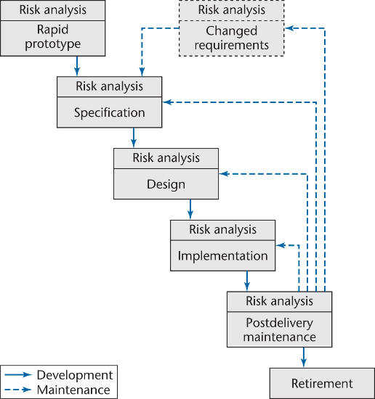
Spiral Model
Simplified form
Rapid prototyping model plus risk analysis preceding each phase
Figure 2.12

Slide 74
This loop approach gives rise to structured
iterative lifecycle models.
In 1988 Boehm developed the spiral model as
an iterative model which includes risk
analysis and risk management.
Key idea: on each iteration identify and solve
the sub-problems with the highest risk.

Slide 75
Cumulative cost
Evaluate alternatives,
Identify & resolve risks
Determine objectives,
alternatives & constraints
Prototypes
Operational
Prototype
Review &
commitment
Start
P1
P2
P3
Requirements
plan
Concept
Of Operation
Design,
Validation
& Verification
Detailed design
Development
plan
Requirements
validation
Coding
Integration &
Test plan
Unit & Integration
Testing
End
Acceptance
Testing
Develop & verify
next-level product
Plan next phase

Slide 76
Each cycle follows a waterfall model by:
Determining objectives
Specifying constraints
Generating alternatives
Identifying risks
Resolving risks
Developing next-level product
Planning next cycle

Slide 77
Advantages
Realism: the model accurately reflects the iterative nature of software development on projects with unclear requirements
Flexible: incoporates the advantages of the waterfal and rapid prototyping methods
Comprehensive model decreases risk
Good project visibility.

Slide 78
Disadvantages
Needs technical expertise in risk analysis to really work
Model is poorly understood by non-technical management, hence not so widely used
Complicated model, needs competent professional management. High administrative overhead.

Slide 79
A Key Point of the Spiral Model
If all risks cannot be mitigated, the project is immediately terminated

Slide 80
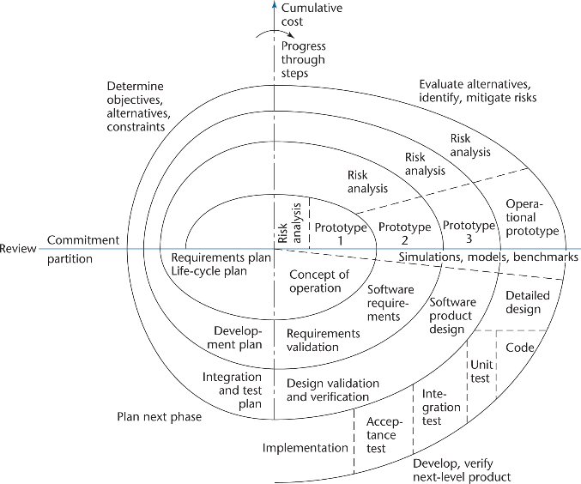
Full Spiral Model (contd)
Figure 2.13

Slide 81
2.10 Comparison of Life-Cycle Models
Different life-cycle models have been presented
Each with its own strengths and weaknesses
Criteria for deciding on a model include:
The organization
Its management
The skills of the employees
The nature of the product
Best suggestion
“Mix-and-match” life-cycle model

Slide 82
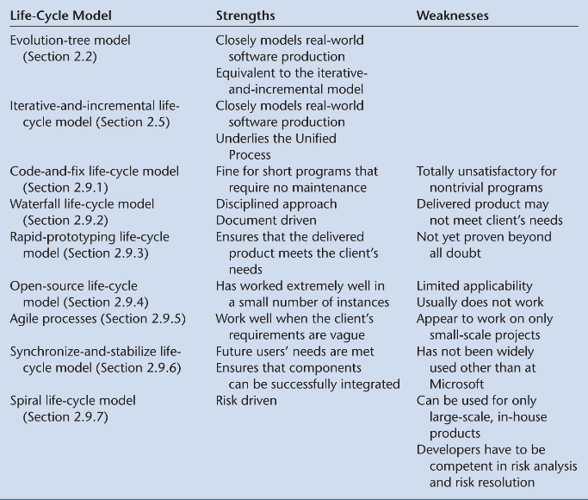
Comparison of Life-Cycle Models (contd)

Slide 83
Thanks shengbin@cs.sjtu.edu.cn
Notes:
Break

